Slide 1

Chapter 10: Intermediate-Code Generation
陳奇業 成功大學資訊工程系

Slide 2
This chapter deals with intermediate representations, static type checking, and intermediate code generation.

Slide 3
In the process of translating a program in a given source language into code for a given target machine, a compiler may construct a sequence of intermediate representations. High-level representations are close to the source language and low-level representations are close to the target machine.

Slide 4
Variants of Syntax Trees
Nodes in a syntax tree represent constructs in the source program; the children of a node represent the meaningful components of a construct. A directed acyclic graph (hereafter called a DAG) for an expression identifies the common subexpressions (subexpressions that occur more than once) of the expression.

Slide 5

Directed Acyclic Graphs for Expressions
Like the syntax tree for an expression, a DAG has leaves corresponding to atomic operands and interior codes corresponding to operators.
The difference is that a node $N$ in a DAG has more than one parent if $N$ represents a common subexpression; in a syntax tree, the tree for the common subexpression would be replicated as many times as the subexpression appears in the original expression.

Slide 8
The Value-Number Method for Constructing DAG's
Often, the nodes of a syntax tree or DAG are stored in an array of records. Each row of the array represents one record, and therefore one node. In each record, the first field is an operation code, indicating the label of the node.

Slide 9
The Value-Number Method for Constructing DAG's

Slide 10
The Value-Number Method for Constructing DAG's
A more efficient approach is to use a hash table, in which the nodes are put into "buckets," each of which typically will have only a few nodes.

Slide 11
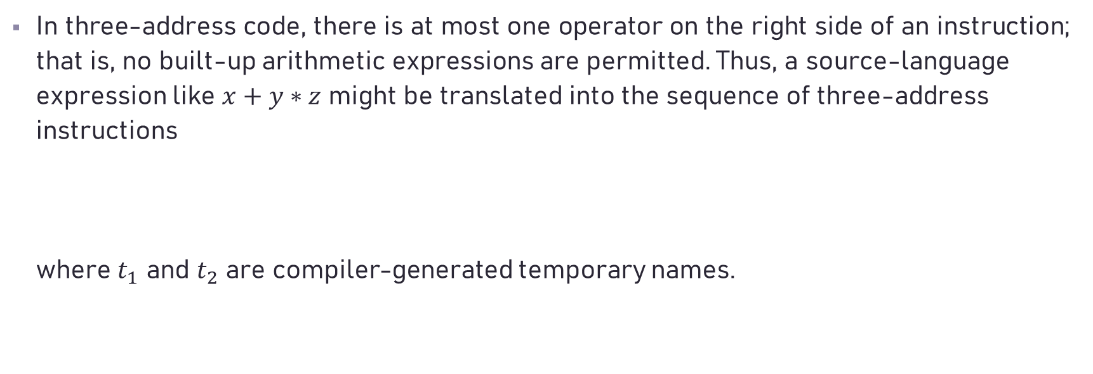
Three-Address Code
In three-address code, there is at most one operator on the right side of an instruction; that is, no built-up arithmetic expressions are permitted. Thus, a source-language expression like $x+y∗z$ might be translated into the sequence of three-address instructions where $t_{1}$ and $t_{2}$ are compiler-generated temporary names.

Slide 13
Addresses and Instructions
Three-address code is built from two concepts: addresses and instructions. An address can be one of the following:
A name. For convenience, we allow source-program names to appear as addresses in three-address code. In an implementation, a source name is replaced by a pointer to its symbol-table entry, where all information about the name is kept.
A constant. In practice, a compiler must deal with many different types of constants and variables.
A compiler-generated temporary. It is useful, especially in optimizing compilers, to create a distinct name each time a temporary is needed. These temporaries can be combined, if possible, when registers are allocated to variables.

Slide 14
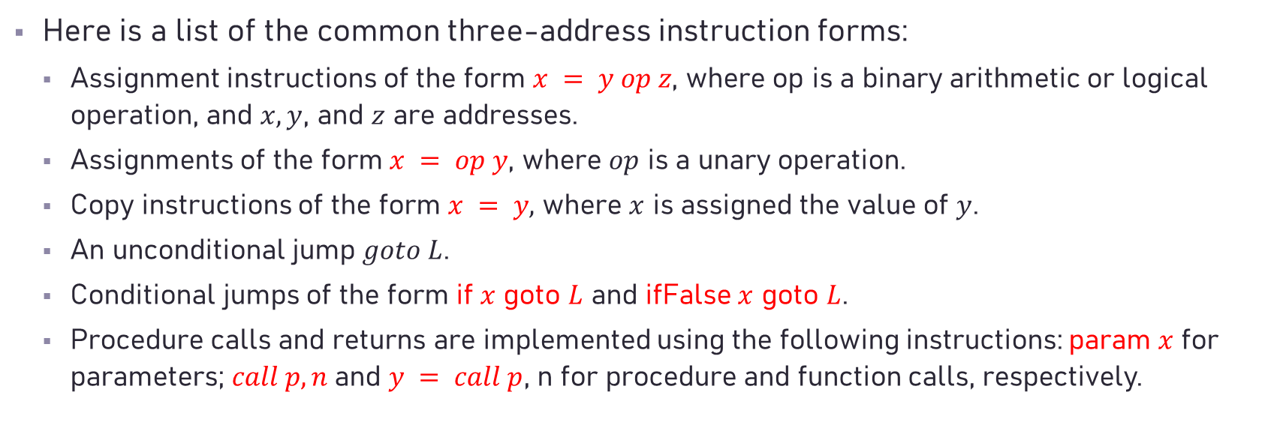
Addresses and Instructions
Here is a list of the common three-address instruction forms:
Assignment instructions of the form $x = y op z$, where op is a binary arithmetic or logical operation, and $x, y$, and $z$ are addresses.
Assignments of the form $x = op y$, where $op$ is a unary operation.
Copy instructions of the form $x = y,$ where $x$ is assigned the value of $y$.
An unconditional jump $goto L$.
Conditional jumps of the form if $x$ goto $L$ and ifFalse $x$ goto $L$.
Procedure calls and returns are implemented using the following instructions: param $x$ for parameters; $call p, n$and $y = call p$, n for procedure and function calls, respectively.

Slide 15
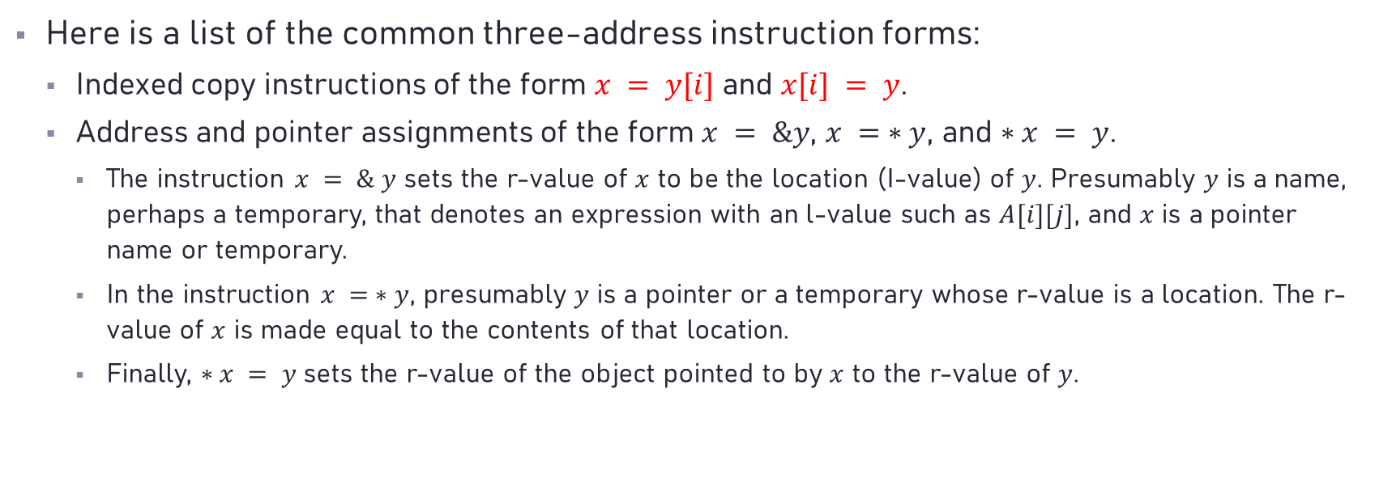
Addresses and Instructions
Here is a list of the common three-address instruction forms:
Indexed copy instructions of the form $x = y[i]$ and $x[i] = y$.
Address and pointer assignments of the form $x = \&y$, $x = ∗y$, and $∗x = y$.
The instruction $x = \& y$ sets the r-value of $x$ to be the location (I-value) of $y$. Presumably $y$ is a name, perhaps a temporary, that denotes an expression with an l-value such as $A[i][j]$, and $x$ is a pointer name or temporary.
In the instruction $x = ∗y$, presumably $y$ is a pointer or a temporary whose r-value is a location. The r-value of $x$ is made equal to the contents of that location.
Finally, $∗x = y$sets the r-value of the object pointed to by $x$ to the r-value of $y$.

Slide 16

Example
Consider the statement
do $i = i+1$; while ($a[i] < v$) ;

Slide 17
Intermediate Code Generation
Three Address Code <-> (Two Address code => Triples)
Quadruples (a collective data structure, each unit is with 4 fields)
Operator Arg1 Arg2 Result
=+
=-
=*
=/
=%
[]=
=[]
….
Note: The entries of operator column are integers that represent
individual operators. The entries of Arg1 (operand1) Arg2
(operand2) and Result are index (pointer) to the symbol table.

Slide 18
Kinds of three-address codes:
1. A = B op⁽¹⁾ C (op is a binary arithmetic or logical operation)
2. A = op⁽²⁾ B (op is a unary operation, e.g. minus, negation, shift
operators, conversion operator, identity operator)
3. goto L (unconditional jump, execute the Lth three-
address code)
4. if A relop B goto L (relop denotes relational operators, e.g., <,
==, >, >=, !=, etc.)
5. param A and call P,n (used to implement a procedure call)
6. A = B [i]
7. A[i] = B
8. A = &B
9. A = *B
10. *A = B

Slide 19
 | Operator | Arg1 | Arg2 | Result
A = B op⁽¹⁾ C | op⁽¹⁾ | B | C | A
A = op⁽²⁾ B | op⁽²⁾ | B |  | A
goto L | goto |  |  | L
if A relop B goto L | relopgoto | A | B | L
param A and call P,n | param | A
 | call | P | n
A = B [i] | =[] | B | i | A
A[i] = B | []= | B | i | A
A = &B | =& | B |  | A
A = *B | =* | B |  | A
*A = B | *= | B |  | A

Slide 20
Example: D = A*B+C
D = A + B * C
The generated three address code is:
ð T1 = A * B T1 = B * C
ð T2 = T1 + C T2 = A + T1
ð D = T2 D = T2
Operator Arg1 Arg2 Result
=* A B T1
=+ T1 C T2
= T2 D
* T1 and T2 are compiler-generated temporary variables and they
are also saved in the symbol table.

Slide 21

Three-address code for the assignment $a=b∗−c+b∗− c$ ;

Slide 22
Actually, in implementation the quadruples look as:
Operator Arg1 Arg2 Result
8 6 7 9
15 9 8 11
3 11 10
index identifier attributes
0 twa
1 K
.. ..
.. ..
6 A
7 B
8 C
9 T1 /* compiler generated temporary variable */
10 D
11 T2 /* compiler generated temporary variable */
in symbol table:

Slide 23

Triples
A triple has only three fields, which we call $op, arg⁡$, and $arg2$.

Slide 24
Types and Declarations
The applications of types can be grouped under checking and translation:
Type checking uses logical rules to reason about the behavior of a program at run time. Specifically, it ensures that the types of the operands match the type expected by an operator.
Translation Applications. From the type of a name, a compiler can determine the storage that will be needed for that name at run time.

Slide 25
Type Expressions
Types have structure, which we shall represent using type expressions: a type expression is either a basic type or is formed by applying an operator called a type constructor to a type expression.
Ex. The array type int [2][3] can be read as "array of 2 arrays of 3 integers each" and written as a type expression array(2, array(3, integer)).

Slide 26
Declarations
We shall study types and declarations using a simplified grammar that declares just one name at a time; declarations with lists of names can be handled as the grammar:

Slide 27
Storage Layout for Local Names
At compile time, we can use these amounts to assign each name a relative address. The type and relative address are saved in the symbol-table entry for the name.
Data of varying length, such as strings, or data whose size cannot be determined until run time, such as dynamic arrays, is handled by reserving a known fixed amount of storage for a pointer to the data.

Slide 28
Storage Layout for Local Names
Suppose that storage comes in blocks of contiguous bytes, where a byte is the smallest unit of addressable memory.
The width of a type is the number of storage units needed for objects of that type. A basic type, such as a character, integer, or float, requires an integral number of bytes.

Slide 29

Storage Layout for Local Names
The translation scheme uses synthesized attributes type and width for each nonterminal and two variables $t$ and $w$ to pass type and width information from a B node in a parse tree to the node for the production $C→ε$. In a syntax-directed definition, $t$ and $w$ would be inherited attributes for $C$.

Slide 30
Example
The parse tree for the type int [2][3]

Slide 31


Sequences of Declarations
$P → MD;$
$M →λ$/* empty string */
$D → D, id$
$| int id$
$| float id$
P
M
D
;
$$λ$$
D
,
id
int
id
int x , y ;

Slide 32
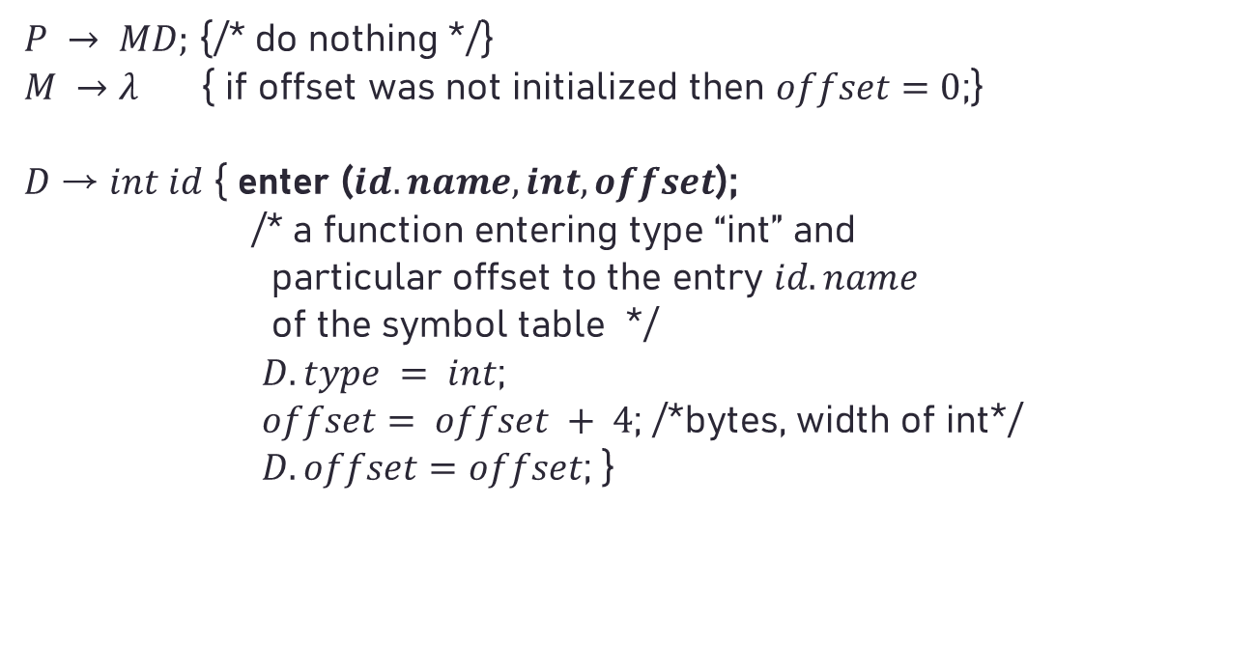
Sequences of Declarations
$P → MD;$ {/* do nothing */}
$M →λ$ { if offset was not initialized then $offset=0$;}
𝐷 → $int id$ { enter ($id.name, int, offset$);
/* a function entering type “int” and
particular offset to the entry $id.name$
of the symbol table */
$D.type = int$;
$offset= offset + 4$; /*bytes, width of int*/
$D.offset=offset$; }

Slide 33
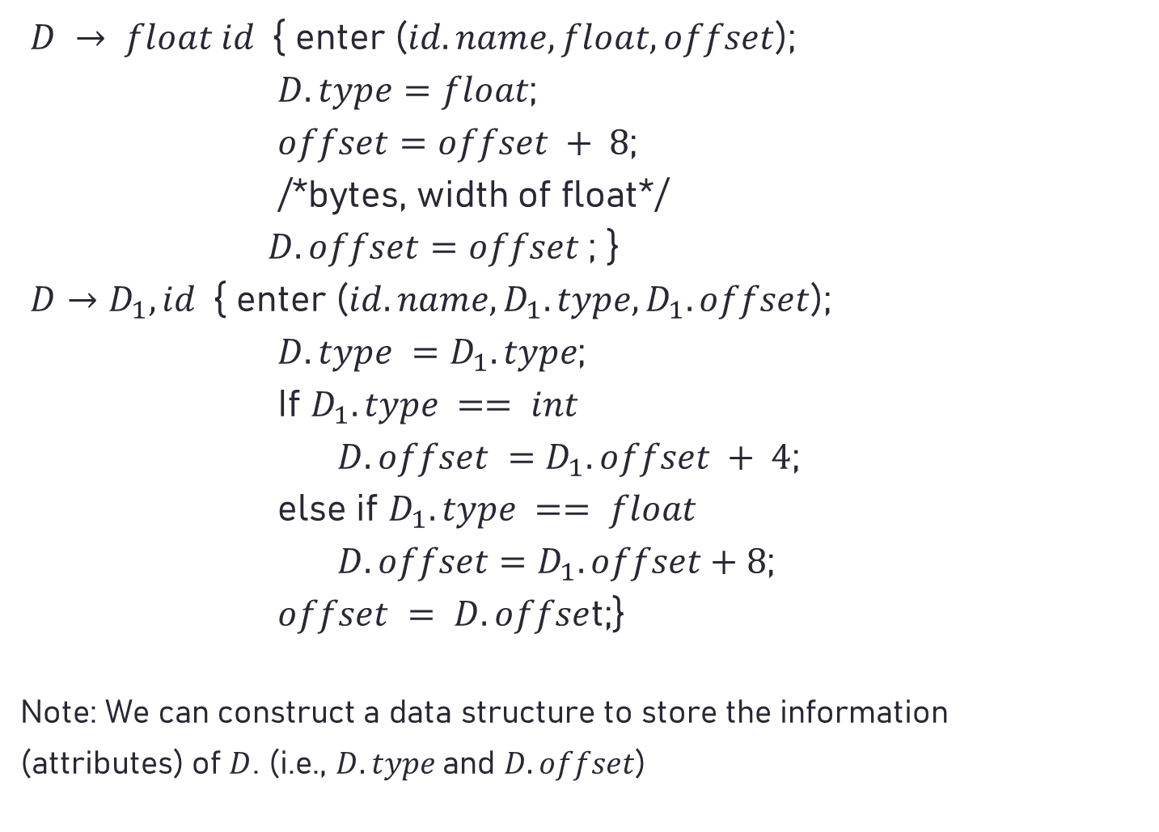
$D → float id${ enter ($id.name, float, offset$);
$D.type=float$;
$offset=offset + 8$;
/*bytes, width of float*/
$D.offset=offset$; }
$D→D_{1}, id${ enter ($id.name,D_{1}.type,D_{1}.offset$);
$D.type =D_{1}.type$;
If $D_{1}.type == int$
$D.offset =D_{1}.offset + 4$;
else if $D_{1}.type == float$
$D.offset=D_{1}.offset+8$;
$offset = D.offse$t;}
Note: We can construct a data structure to store the information
(attributes) of $D$. (i.e., $D.type$and $D.offset$)

Slide 34
Fields in Records and Classes
The translation of declarations carries over to fields in records and classes. Record types can be added to the grammar by adding the following production

Slide 35

Translation of Expressions
We begin in this section with the translation of expressions into three-address code. An expression with more than one operator, like $a+b∗c$, will translate into instructions with at most one operator per instruction. An array reference $A[i][j]$will expand into a sequence of three-address instructions that calculate an address for the reference.

Slide 36
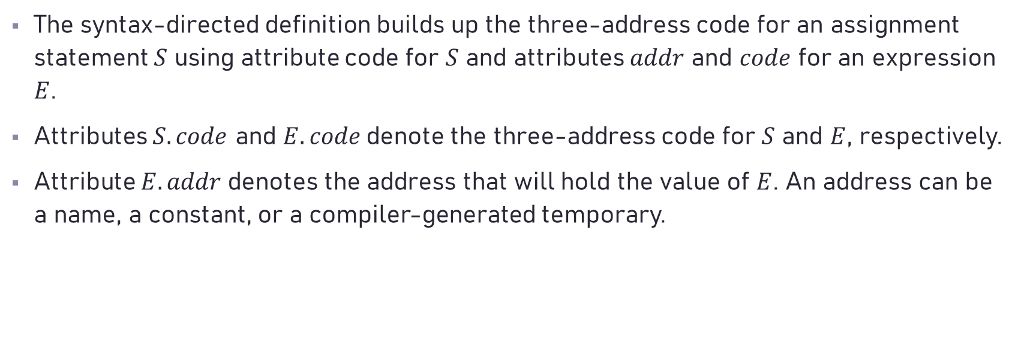
Operations Within Expressions
The syntax-directed definition builds up the three-address code for an assignment statement $S$ using attribute code for $S$ and attributes $addr$ and $code$ for an expression $E$.
Attributes $S.code$ and $E.code$denote the three-address code for $S$ and $E$, respectively.
Attribute $E.addr$denotes the address that will hold the value of $E$. An address can be a name, a constant, or a compiler-generated temporary.

Slide 37
Operations Within Expressions

Slide 38
Incremental Translation
Like to build a syntax tree

Slide 39
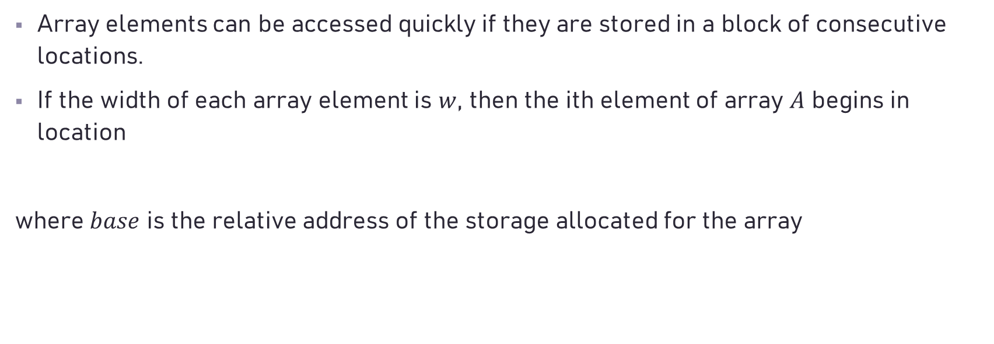
Addressing Array Elements
Array elements can be accessed quickly if they are stored in a block of consecutive locations.
If the width of each array element is $w$, then the ith element of array $A$ begins in location
where $base$ is the relative address of the storage allocated for the array

Slide 40

Addressing Array Elements
The relative address of $A[i_{1}][i_{2}]$ can then be calculated by the formula
In $k$ dimensions, the formula is

Slide 41

Addressing Array Elements
In two dimensions (i.e., $k = 2$and $w = w_{2}$), the location for $A[i_{1}][i_{2}]$ is given by
In $k$ dimensions, the formula is

Slide 42

Addressing Array Elements
More generally, array elements need not be numbered starting at 0. In a one-dimensional array, the array elements are numbered $low, low + 1, . . . , high$and $base$ is the relative address of $A[low]$. The address of $A[i]$ is

Slide 43
Addressing Array Elements

Slide 44

Translation of Array References
Let nonterminal $L$ generate an array name followed by a sequence of index expressions:

Slide 45

Translation of Array References
$L.addr$ denotes a temporary that is used while computing the offset for the array reference by summing the terms $i_{j}×w_{j}$.
$L.array$is a pointer to the symbol-table entry for the array name. The base address of the array, say, $L.array.base$is used to determine the actual 1-value of an array reference after all the index expressions are analyzed.
$L.type$ is the type of the subarray generated by $L$. For any type $t$, we assume that its width is given by $t.width$. For any array type $t$, suppose that $t.elem$gives the element type.

Slide 46
Example

Slide 48
Example

Slide 49
Arithmetic Statements
A -> id = E
E -> E⁽¹⁾ + E⁽²⁾
E -> E⁽¹⁾ - E⁽²⁾
E -> E⁽¹⁾ * E⁽²⁾
E -> E⁽¹⁾ / E⁽²⁾
E -> - E⁽¹⁾
E -> (E⁽¹⁾)
E -> id
A
id
=
E
E
+
E
id
id
x = a + b
T1 = a + b
x = T1

Slide 50
A -> id = E { GEN (id.addr = E. addr); }
/* GEN (argument) - a function used to save its argument into the quadruple. The implementation of E is a data structure with one field E.addr which holds the name that will hold the index value of the symbol table. */
E -> E⁽¹⁾ + E⁽²⁾ { T = NEWTEMP();
/* NEWTEMP() - a function used to generate a
temporary variable T and save T into symbol
table and return the index value of the symbol
table. */
E. addr = T;
/* T’s index value in symbol table is assigned to
E.addr */
GEN(E.addr = E⁽¹⁾.addr + E⁽²⁾.addr); }
T = a + b

Slide 51
E -> E⁽¹⁾ * E⁽²⁾ { T = NEWTEMP();
E.addr = T;
GEN(E.addr = E⁽¹⁾.addr * E⁽²⁾.addr); }
E -> - E⁽¹⁾ { T = NEWTEMP();
E.addr = T;
GEN(E.addr = -E⁽¹⁾.addr); }
E -> (E⁽¹⁾) { E.addr = E⁽¹⁾.addr; }
E -> id { E.addr = id.addr; }
/*將id之符號表index值傳給E之field 'place' ; In
implementation id.addr refers to the index value
of id in the symbol table. */

Slide 52
Enhanced version for E -> E⁽¹⁾ op E⁽²⁾
**注意in this version E所對應資料結構之設計 (應以array of struct of E之資料結構來儲存各個E之attributes, 並將對應之array index值儲存於E對應之value stack中)
{ T = NEWTEMP();
if E⁽¹⁾.type == int and E⁽²⁾.type == int then
{ GEN (T = E⁽¹⁾.addr intop E⁽²⁾.addr);
E.type = int;
}
else if E⁽¹⁾.type == float and E⁽²⁾.type == float then
{ GEN (T = E⁽¹⁾.addr floatop E⁽²⁾.addr);

Slide 53
E.type = float;
}
else if E⁽¹⁾.type == int and E⁽²⁾. type == float then
{ U = NEWTEMP();
GEN (U = inttofloat E⁽¹⁾.addr);
GEN (T = U floatop E⁽²⁾.addr);
E.type = float;
}
else /* E⁽¹⁾.type == float and E⁽²⁾.type == int then
{ U = NEWTEMP();
GEN (U = inttofloat E⁽²⁾.addr);
GEN (T = E⁽¹⁾.addr floatop U);
E.type = float;
}
}

Slide 54
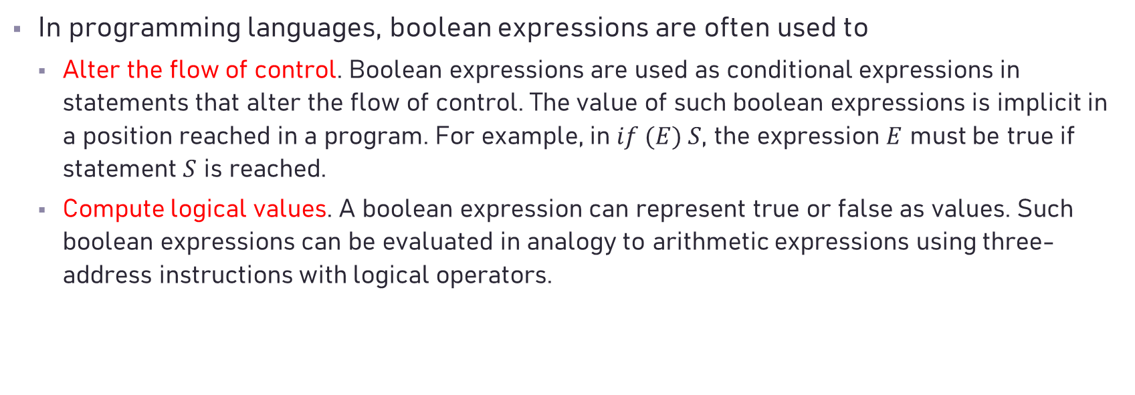
Control Flow
In programming languages, boolean expressions are often used to
Alter the flow of control. Boolean expressions are used as conditional expressions in statements that alter the flow of control. The value of such boolean expressions is implicit in a position reached in a program. For example, in $if (E) S$, the expression $E$ must be true if statement $S$ is reached.
Compute logical values. A boolean expression can represent true or false as values. Such boolean expressions can be evaluated in analogy to arithmetic expressions using three-address instructions with logical operators.

Slide 55
Boolean Expressions
M -> ε
E -> E or M E
| E and M E
| not E
| ( E )
| id
| id relop id

Slide 56
An example
if p < q || r < s && t < u
x = y + z;
k = m – n;
For the above boolean expression the corresponding contents in the quadruples are:

Slide 57
quadruples
if p < q || r < s && t < u
x = y + z;
k = m – n;
Location Three-Address Code
… ………….
100 if p < q goto 106
101 goto 102
102 if r < s goto 104
103 goto 108
104 if t < u goto 106
105 goto 108 /*s.next = 105
106 t1 = y + z
107 x = t1
108 t2 = m - n
109 k = t2
... .........
E
counter = 100
E or M E
ε
id < id
E and M E
ε
id < id
id < id

Slide 58
NEXTQUAD – an integer variable used for saving the index (location)
value of the next available entry of the quadruples.
E.true – an attribute of E that holds a set of indexes (locations) of the
quadruples, each indexed quadruple saves the three-address code
with ‘true’ boolean expression.
E.false – an attribute of E that holds a set of indexes of the
quadruples, each indexed quadruple saves the three-address code
with ‘false’ boolean expression.
GEN(x) – a function that translates x (a kind of three-address-code) into
quadruple representation.
So, we need to construct a data structure for E which includes two
fields, each field can save an unlimited number of integer.
Meanwhile, we need to construct an array of this E’s structure to
store several Es’ attributes to be used in the same period of time .

Slide 59
1. M -> ε { M.quad = NEXTQUAD; }
/* M.quad is a data structure associated with M */
2. E -> E⁽¹⁾ or M E⁽²⁾
{
BACKPATCH (E⁽¹⁾.false, M.quad);
E.true = MERGE (E⁽¹⁾.true, E⁽²⁾.true);
E.false = E⁽²⁾.false;
}
/* BACKPATCH (p, i) – a function that makes each of the
quadruple index values on the list pointed to by p take
quadruple i as a target (i.e., goto i).*/
/* MERGE (a, b) – a function that takes the lists pointed to by a and b, concatenates them into one list, and returns a pointer to the concatenated list. */

Slide 60
3. E -> E⁽¹⁾ and M E⁽²⁾
{
BACKPATCH (E⁽¹⁾.true, M.quad);
E.true = E⁽²⁾.true;
E.false = MERGE (E⁽¹⁾.false, E⁽²⁾.false);
}
4. E -> not E⁽¹⁾
{ E.true = E⁽¹⁾.false; E.false = E⁽¹⁾.true;}
5. E -> ( E⁽¹⁾ )
{ E.true = E⁽¹⁾.true; E.false = E⁽¹⁾.false;}

Slide 61
6. E -> id
{
E.true = MAKELIST (NEXTQUAD);
E.false = MAKELIST(NEXTQUAD + 1);
GEN (if id.addr goto _ );
GEN (goto _);
}
/* MAKELIST ( i ) – a function that creates a list containing i, an index into the array of quadruples, and returns a pointer to the list it has made. */
/* GEN(x) – a function that translates x (a kind of three-address-code) into quadruple representation. */

Slide 62
7. E -> id⁽¹⁾ relop id⁽²⁾
{
E.true = MAKELIST (NEXTQUAD);
E.false = MAKELIST(NEXTQUAD + 1);
GEN (if id⁽¹⁾.addr relop id⁽²⁾.addr goto _ );
GEN (goto _);
}
NEXTQUAD
if id⁽¹⁾.addr relop
id⁽²⁾.addr goto _
20
21
goto _
E
true
false
22
20
….
…
21

Slide 63
Flow-of-Control statements
A. Conditional Statements
S -> if E then S else S
| if E then S
| A
| begin L end
L -> S
| L ; S
/* A – denotes a general assignment statement
L – denotes statement list
S – denotes statement */

Slide 64
1. S -> if E then M⁽¹⁾ S⁽¹⁾ N else M⁽²⁾ S⁽²⁾
{
BACKPATCH (E.true, M⁽¹⁾.quad);
BACKPATCH (E.false, M⁽²⁾.quad);
S.next = MERGE (S⁽¹⁾.next, N.next, S⁽²⁾.next);
}
/* S.next is a pointer to a list of all conditional and unconditional jump (goto) to the quadruple following the statement S in execution order. */

Slide 65
2. S -> if E then M S⁽¹⁾
{
BACKPATCH (E.true, M.quad);
S.next = MERGE (E.false, S⁽¹⁾.next)
}
3. M -> ε { M.quad = NEXTQUAD; }
4. N -> ε
{
N.next = MAKELIST (NEXTQUAD);
GEN (goto _);
}
N
next
NEXTQUAD = 20
20
20
Goto ___
NEXTQUAD

Slide 66
5. S -> A
{ S.next = null; }
/* initialize S.next to an empty list */
6. L -> S { L.next = S.next; }
7. L -> L⁽¹⁾ ; M S
{
BACKPATCH (L⁽¹⁾.next, M.quad); // To resolve all quadruples with conditional & unconditional unresolved ‘goto _’
L.next = S.next;
}
8. S -> begin L end { S.next = L.next; }

Slide 67
Iterative Statement
S -> while E do S
9. S -> while M⁽¹⁾ E do M⁽²⁾ S⁽¹⁾
{
BACKPATCH (E.true, M⁽²⁾.quad);
BACKPATCH (S⁽¹⁾.next, M⁽¹⁾.quad);
S.next = E.false;
GEN (goto M⁽¹⁾.quad);
}

Slide 68
An example: while (A<B) do if (C<D) then X = Y + Z;
E
E
Index Three-Address Code
… …..
100 if (A<B) goto 102
101 goto __ //will be resolved (filling 107) later
102 if (C<D) goto 104
103 goto 100
104 T = Y + Z
105 X = T
106 goto 100
107 …
2
1
If (C<D) then X=Y+Z;
3

Slide 69
6. Procedure calls
1. call -> id (args)
2. args -> args , E
3. args -> E
1. call -> id (args)
{ for each item p on QUEUE do
GEN (param p);
GEN (call id.addr, length of QUEUE); }
/* QUEUE is a data structure for saving the indexes of the symbol table containing the names of the arguments. The length of QUEUE is the number of elements in QUEUE */

Slide 70
2. args -> args , E
{ append E.addr to the end of QUEUE; }
3. args -> E
{ initialize QUEUE to contain only
E.addr; }
/* Originally, QUEUE is empty and, after the reduction of E to args, QUEUE contains a single pointer to the symbol table location for the name that denotes the value of E. */

Slide 71
Structure Declarations
type -> struct { fieldlist} /*Note: symbols with bold face are
terminals */
| ptr
| char
| int
| float
| double
fieldlist -> fieldlist field;
| field;
field -> type id
| field [integer /*a token denoting any string of digits*/]
struct { int x; //offset 0
float y; //offset 2
char k[10];//offset 6
} m;
m.width = 16 bytes
int x
int x [10] [20] [30]
field
int x [10] or

Slide 72
field -> type id
{ field.width = type.width;
field.name = id.name;
W_enter(id.name, type.width);}
/* W_enter(name,width) enters ‘width’ as the width of each element of ‘name’. If ‘name’ is not an array, then its width is the number of locations taken by data of name’s type. */
| field⁽¹⁾ [integer]
{ field.width = field⁽¹⁾.width * integer.val;
field.name = field⁽¹⁾.name;
D_enter(field⁽¹⁾.name, integer.val);}

Slide 73
/* D_enter(name,size) increases the number of dimensions for ‘name’ by one and enters the last dimension as ‘size’ in the symbol table entry for ‘name’. */
fieldlist -> field; {O_enter (field.name, 0); fieldlist.width =
field.width;}
/* O_enter(name,offset) makes ‘offset’ the number for which field name ‘name’ stands. This information, also, is recorded in the symbol table entry for ‘name’. */
|fieldlist⁽¹⁾ field; { fieldlist.width = fieldlist⁽¹⁾.width
+ field.width;
O_enter(field.name, fieldlist⁽¹⁾.width);}

Slide 74
type -> struct '{' fieldlist '} ' { type.width = fieldlist.width; }
type -> char { type.width = 1; } /* Assume characters take one
byte.*/
type -> ptr {type.width = 4; } /*Assume pointers take four
bytes.*/
type -> int { type.width = 2; } /* Assume integers take two
bytes.*/
.......

Slide 75
Switch Statement
Syntax:
switch E
{
case V1: S1;
case V2: S2;
.............
.............
case Vn-1: Sn-1;
default: Sn;
}

Slide 76
When translated into three-address code:
100 Code to evaluate E into T
101 If T ≠ V1 goto 104
102 Code for S1
103 Goto 113
104 If T ≠ V2 goto 107
105 Code for S2
106 Goto 113
107 ...
108 ...
109 If T ≠ Vn-1 goto 112
110 Code for Sn-1
111 Goto 113
112 code for Sn
113 ….
Temporary variable

Slide 77
Symbol Table
The principal symbol table operations are insert, lookup, and delete; other operations may also be necessary.
The insert operation is used to store the information provided by name declarations when processing these declarations.
The lookup operation is needed to retrieve the information associated to a name when that name is used in the associated code.
The delete operation is needed to remove the information provided by a declaration when that declaration no longer applies.

Slide 78
The Structure of the Symbol Table
Typical implementations of dictionary structures include linear lists, various search tree structures (binary search trees, AVL trees, B trees), and hash tables.
Linear lists are a good basic data structure that can provide easy and direct implementations of the three basic operations, with a constant-time operation (by always inserting at the front or rear) and lookup and delete operations that are linear time in the size of the list.

Slide 79
Hash Tables

Slide 80
Declarations
There are four basic kinds of declarations that occur frequently in programming languages:
constant declarations
type declarations
variable declarations
procedure/function declarations

Slide 81
Scope Rules and Block Structure
Declaration before use is a common rule, used in C and Pascal, that requires that a name be declared in the text of a program prior to any references to the name.
Declaration before use permits the symbol table to be built as parsing proceeds and for lookups to be performed as soon as a name reference is encountered in the code.
If the lookup fails, a violation of declaration before use has occurred, and the compiler will issue an appropriate error message.

Slide 82
Scope Rules and Block Structure
Block structure is a common property of modern languages.

Slide 83
Scope Rules and Block Structure
To implement nested scopes and the most closely nested rule, the symbol table insert operation must not overwrite previous declarations, but must temporarily hide them, so that the lookup operation only finds the most recently inserted declaration for a name.
Similarly, the delete operation must not delete all declarations corresponding to a name, but only the most recent one, uncovering any previous declarations.

Slide 85
Scope Rules and Block Structure
A number of alternatives to this implementation fo nested scopes are possible. One solution is to build a new symbol table for each scope and to link the tables from inner to outer scopes together, so that the lookup operation will automatically continue the search with an enclosing table if it fails to find a name in the current table.

